Slide 1

Health & Wellness
Click Once to Begin

Slide 2

VEGGIES & FRUIT
DAIRY & GRAINS
HEALTHY CHOICES
FAST FOODS
PROTEIN FACTS
PHYSICAL ACTIVITY
100
100
100
100
100
100
200
200
200
200
200
200
300
300
300
300
300
300
400
400
400
400
400
400
500
500
500
500
500
500

Slide 3
Daily Double Graphic and Sound Effect!
Daily Double!!!
DO NOT DELETE THIS SLIDE! Deleting it may cause the game links to work improperly. This slide is hidden during the game, and WILL not appear.
In slide view mode, copy the above (red) graphic (click once to select; right click the border and choose “copy”).
Locate the answer slide which you want to be the daily double
Right-click and choose “paste”. If necessary, reposition the graphic so that it does not cover the answer text.

Slide 4

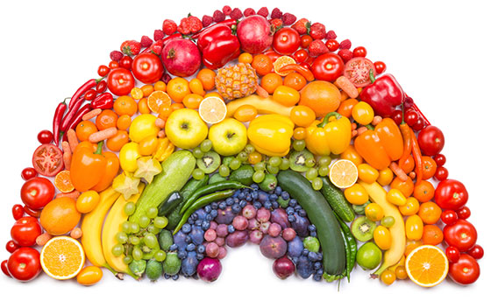

True or false?
It is important to eat vegetables and fruit every day.

Slide 5
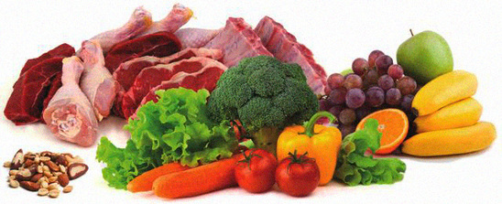
True or false?
FALSE!
Half your plate should be fruits and vegetables
Servings of fruit and vegetables should be the same as meat or protein for a well-balanced nutritious diet.

Slide 6
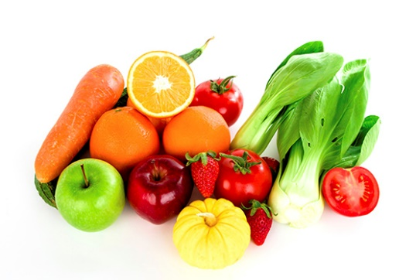
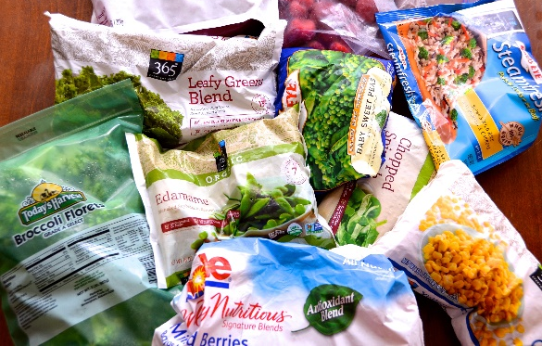
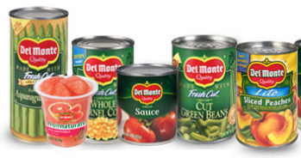
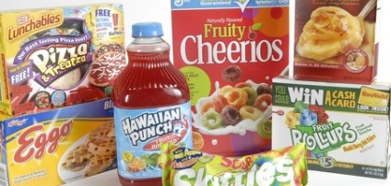
Which is better?
1
Fresh & Whole
Frozen
Canned
Processed Foods
2
3
4

Slide 7

Daily Double!!!

Slide 8
Name one vegetable or fruit for each color:
Red
Yellow
Green
Orange

Slide 9
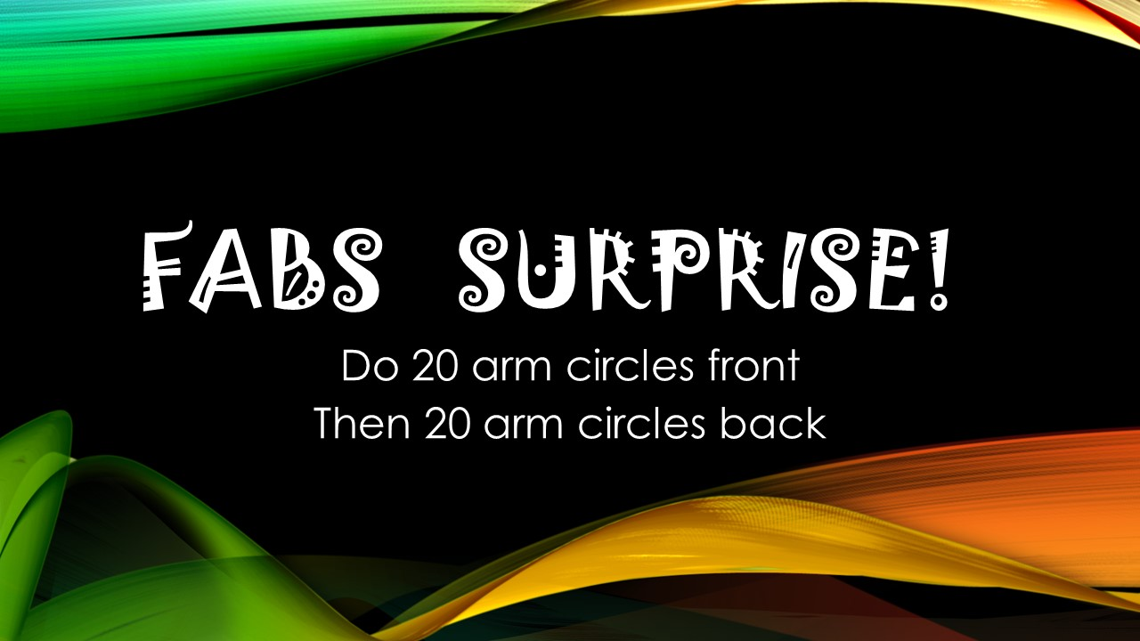
Daily Double!!!

Slide 10

Which 2 statements are true about non-fat milk?
It provides all the same nutrients as whole milk, except the fat.
It is watered down whole milk.
It comes from skinny cows.
It is a more healthy choice.

Slide 11
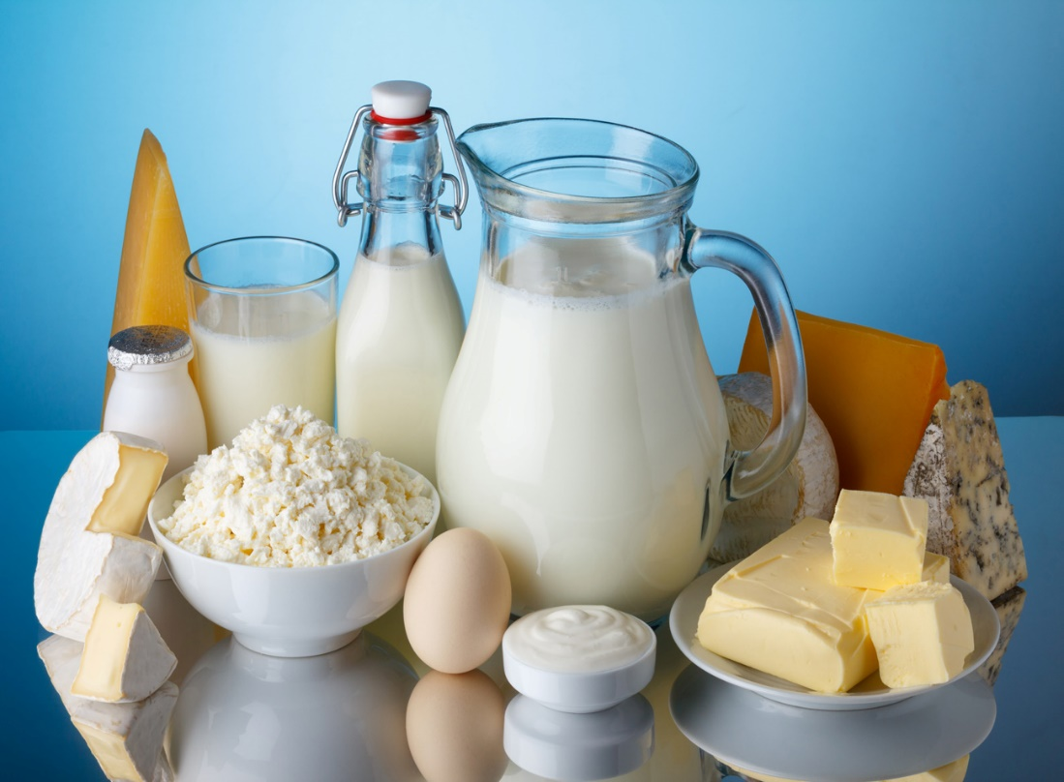
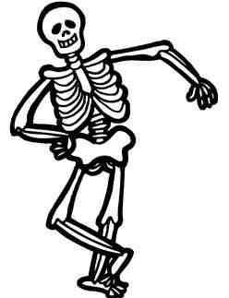
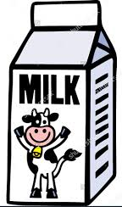
Why are dairy products good for you?
Dairy contains nutrients like calcium, potassium, vitamin D, and protein that are good for your health and Build strong bones!

Slide 12
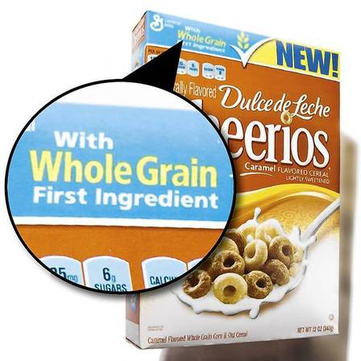
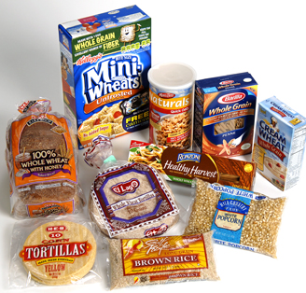
True or false?
You can buy ALL of the following foods made with whole grains:
Bread
Pasta
Cereal
Rice
Crackers
Pancakes

Slide 13
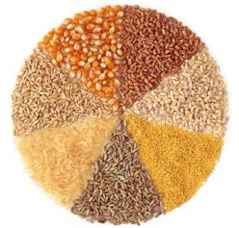
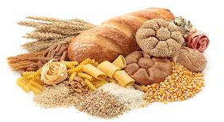
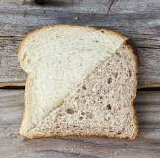
How much of your grains should be whole grains?
At least
Half! ☺
Make ½ your grains whole!!

Slide 14
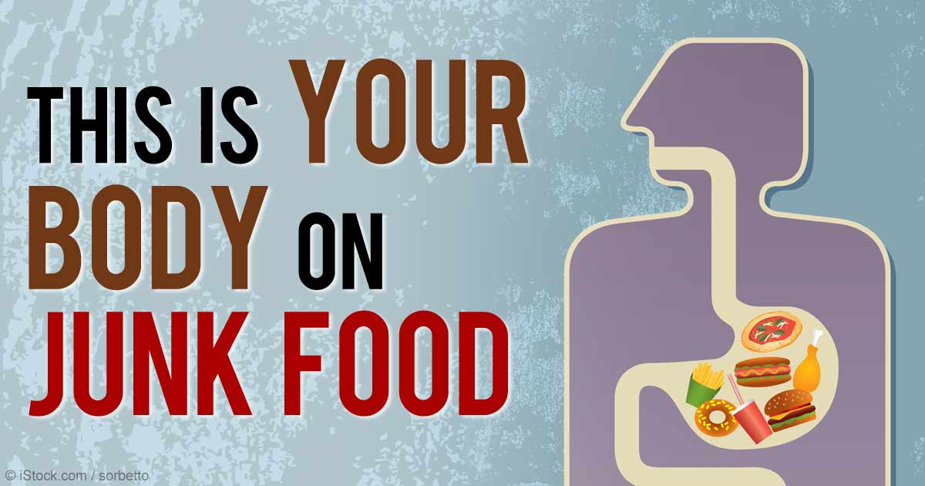
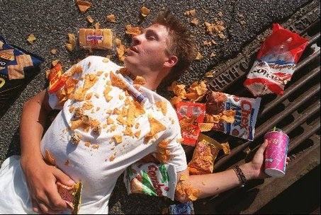
What could happen to you if you eat mostly junk food?
Get constipated
Feel bad and have no energy
Not get all the vitamins your body needs
Have unhealthy skin and hair
All of the above

Slide 15
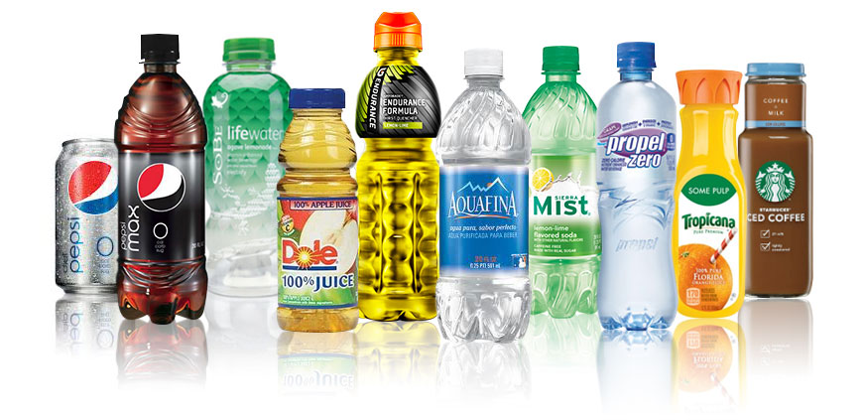
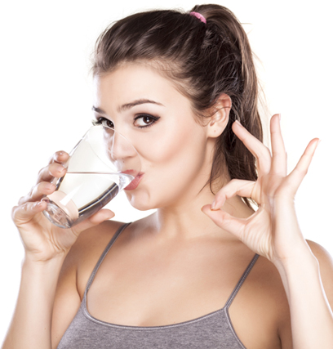
What is the healthiest thing you can drink?
Juice
Soda
Coffee
Water
Tea
Sports Drink
Lemonade
WATER

Slide 16
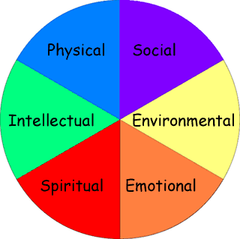

True or false?
Physical activity and good nutrition are the only important things to focus on when trying to be healthy.
Health is holistic, which means that it is important to focus on all the aspects of health and how they connect to one another to be the healthiest self you can be.

Slide 17
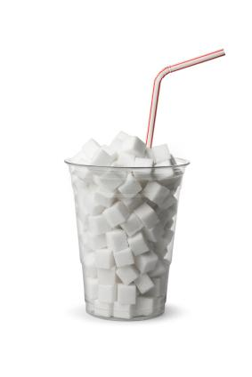
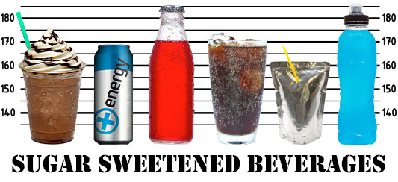
Each year, THE AVERAGE AMERICAN consumes 32 Pounds (lbs.) of Sugar from DRINKS LIKE soda.
What are 2 reasons SUGARY BEVERAGES ARE bad for you?
Sugar is bad for you for lots of reasons: increases your risk for diabetes or weight gain and health problems associated with being overweight including heart disease; sugar can be addictive; its bad for your dental health; has no real nutrients

Slide 18

Daily Double!!!

Slide 19
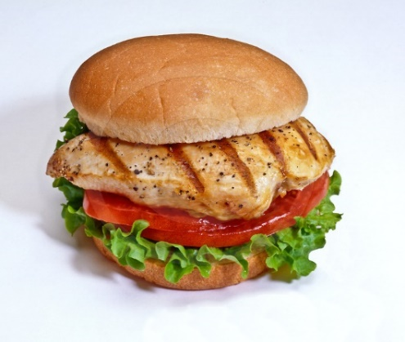
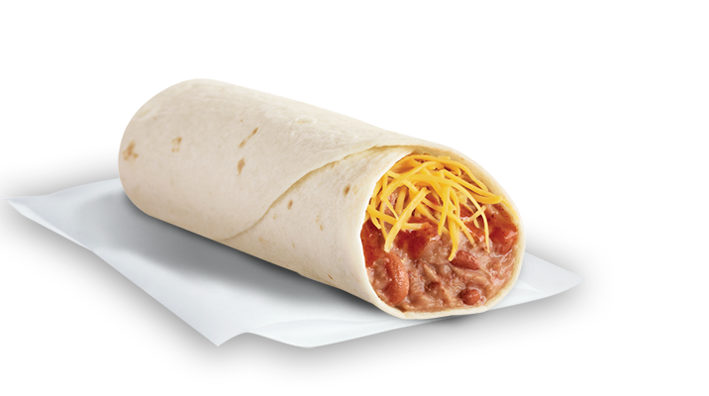
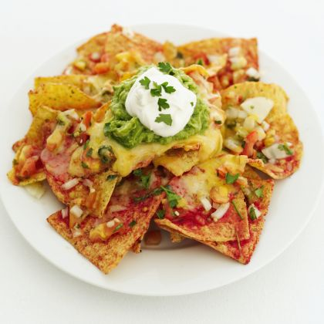
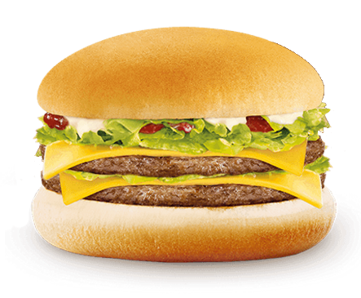
Which 2 of the following fast food options are healthier choices?
Grilled Chicken Sandwich
Bean Burrito
Nachos Grande
Double Cheeseburger

Slide 20
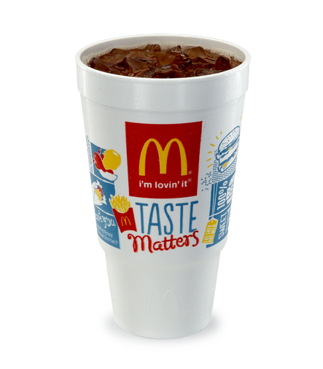

True or false?
A 30 oz. McDonald’s sweet tea has MORE sugar in it than
2 Snickers bars
30 oz. sweet tea has 71 grams of sugar
1 snickers has 27 grams of sugar with a total of 54 grams for the two

Slide 21
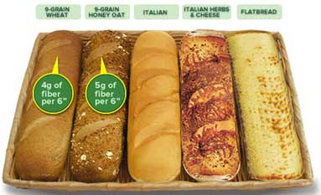


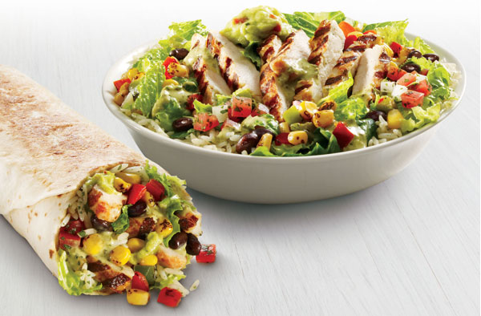

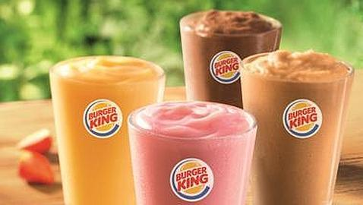
Name one item at each fast food restaurant that is a healthier choice.
Subway
Taco Bell
Use your best judgement in choosing foods that have less fat, are grilled, whole wheat, chicken, and have fruit or veggies

Slide 22
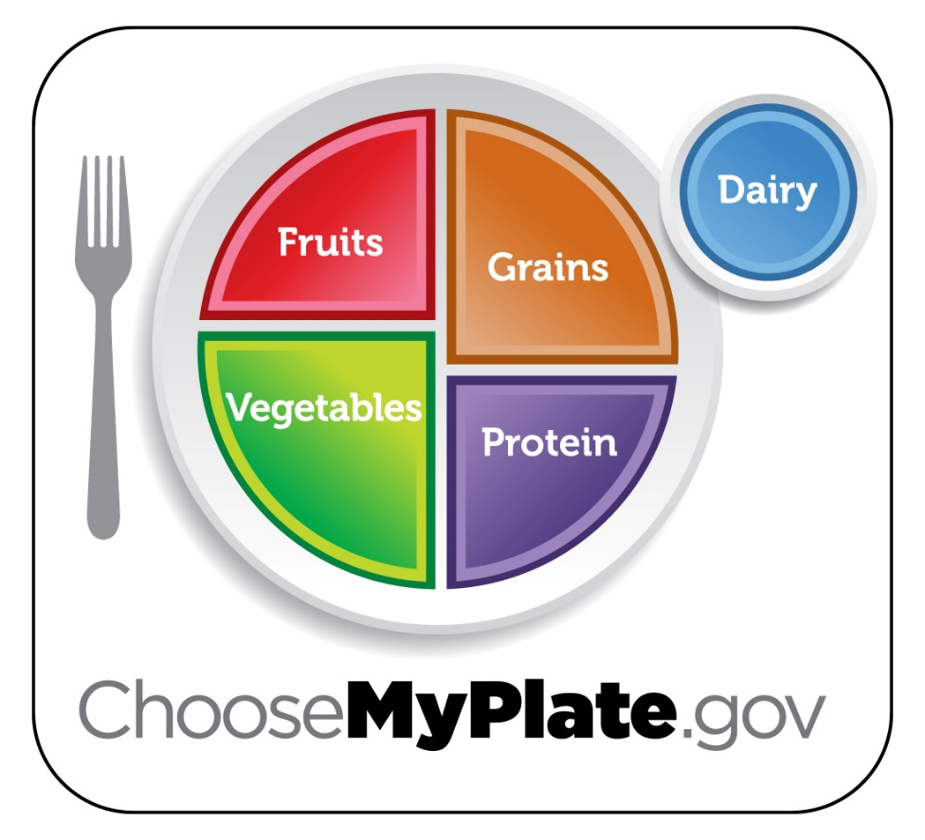

It is important to eat balanced meals
Daily Double!!!
FOR DOUBLE POINTS!!
Name and place the 5 food groups from MyPlate.

Slide 23





Daily Double!!!
FOR DOUBLE POINTS!!
What companies match up to these four logos:

Slide 24
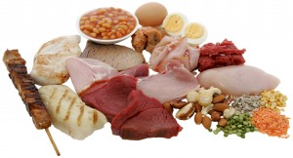
Why is protein good for you?
Protein provides lots of good nutrients and vitamins that build strong muscles and bones as well as hair and nails. In addition to fiber, protein also helps you feel full longer.

Slide 25
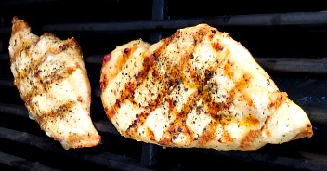

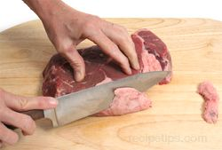
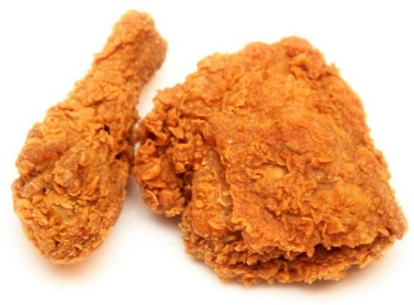
Name 2 ways you can prepare your meat so it is lean and does not have a lot of fat.
1. Trim off the fat
2. Grilled meat instead of Fried

Slide 26
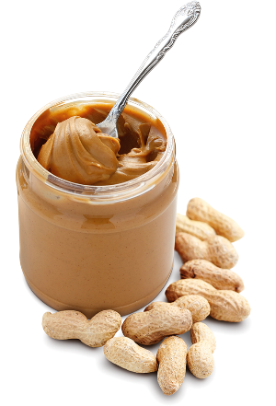
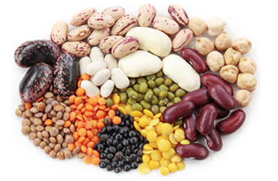
True or false?
Peanut butter and other nuts, beans, and legumes in the protein group are a good replacement for meat.

Slide 27
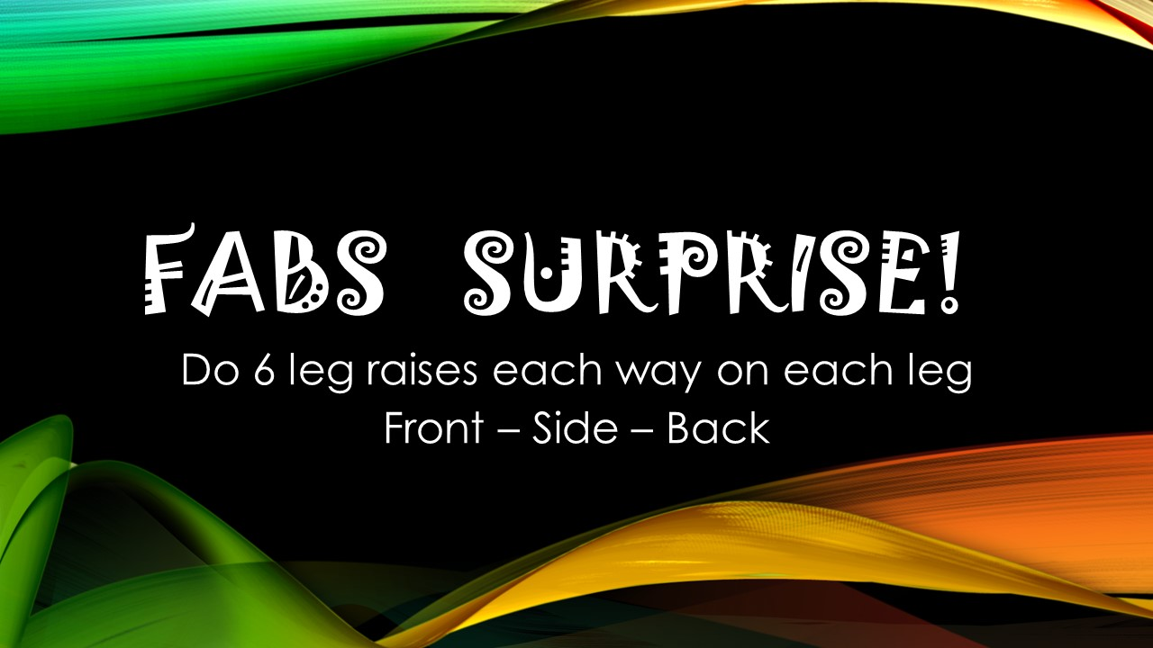
Daily Double!!!
(You can do this while sitting down or use your arms instead of your legs)

Slide 28
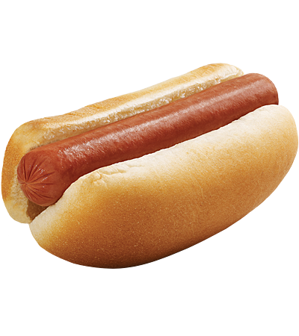
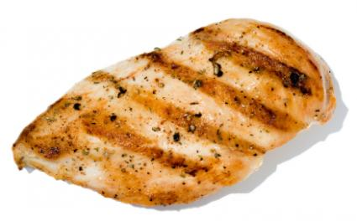
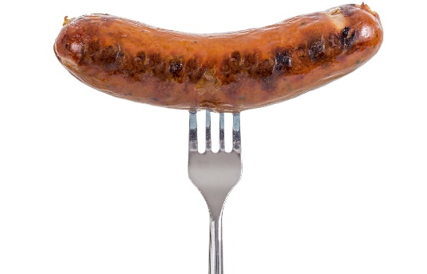
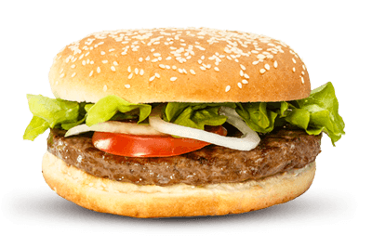
Which one of the following has the least amount of fat?
Beef Hot Dog
Roasted Skinless Chicken Breast
Sausage
Hamburger

Slide 29
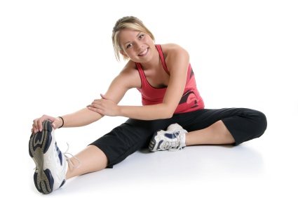
Which one is false?
Benefits of stretching your muscles include:
Better Flexibility
You will be taller
Better Balance
You can prevent injury

Slide 30


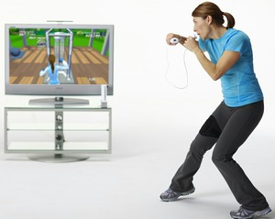

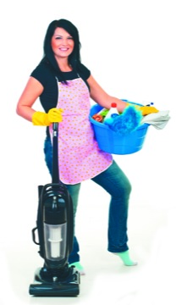

Which of the following is not Being “physically active”?
Working in the garden
Walking the dog
Playing Wii
Dancing
Cleaning the house
Playing chess

Slide 31
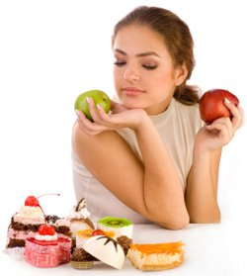
True or false?
If you are happy with your weight, you do not need to exercise or worry about what you eat.
Eating healthy and exercising are both an important part of being the best and most healthy person you can be. Even if you are not trying to lose weight you should still focus on good nutrition and staying physically active.

Slide 32
Explain how being physically active affects your:
Social Health
&
Emotional Health
Daily Double!!!
FOR DOUBLE POINTS!!
Example Answers:
Being on a sports team can build friendships
Relieves stress and anxiety
Build confidence
Being physically active is a fun activity to do with your friends

Slide 33

Which of the following is NOT true about aerobic activity?
Good for your heart
Is moderate to high intensity where you can talk but not sing
Also known as ‘Cardio Activity’
Is really easy to do and does not take much effort

