Slide 1

Wellness Edge
Subawards
The project described is supported by Grant Number 90PRRC0001-01-00 from the Administration for Community Living, Department of Health and Human Services. Its contents are solely the responsibility of the Wellness Edge staff and do not necessarily represent the official views of the Administration for Community Living Or HHS

Slide 2
Wellness Edge team
Jason Jones
Lindsey Mullis
Chithra Adams
Kathy Sheppard- Jones
And you– Our subawardees!!

Slide 3
Questions
Please post your questions in the chatbox or email it to wellnessedge@uky.edu
FAQ answer sheet available on project website
https://www.wellness4ky.org/wellnessedge/

Slide 4
Agenda
Project Examples
Proposal Criteria
Milestone Payments
Things to consider
TA for WRITING grant
FAQs

Slide 5
Program Examples

Slide 6
SHARE – Independence Place
The Social, Healthy, Adaptive Recreation & Exercise (SHARE) project improves health outcomes for people with/without paralysis through recreational events. Each event is integrated and adapted for people of all abilities. The purpose of each event is to promote community inclusion, encourage healthy activity routines, and lessen the impact of secondary health complications associated with paralysis. SHARE is innovative in that it emphasizes the commonality between people with/without paralysis, features continuous wellness events throughout the year, and creates a venue that fosters discussion and understanding about health and wellness from varying perspectives.

Slide 7
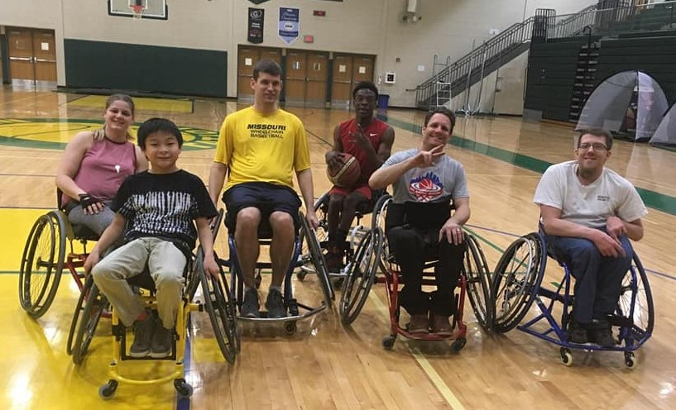
TIRP-Fayette County Schools
The goal of The Inclusive Recreation Program (TIRP) is to allow students with mobility issues (paralysis in particular) to participate in physical activities with their support network under the guidance of experienced adaptive recreation sponsors to provide physical, emotional and social wellness to students. This program is an introduction to adaptive recreation for students middle and high school aged and an invitation to develop life long healthy habits and create pathways to additional recreation and potential competitive opportunities throughout the community.

Slide 8
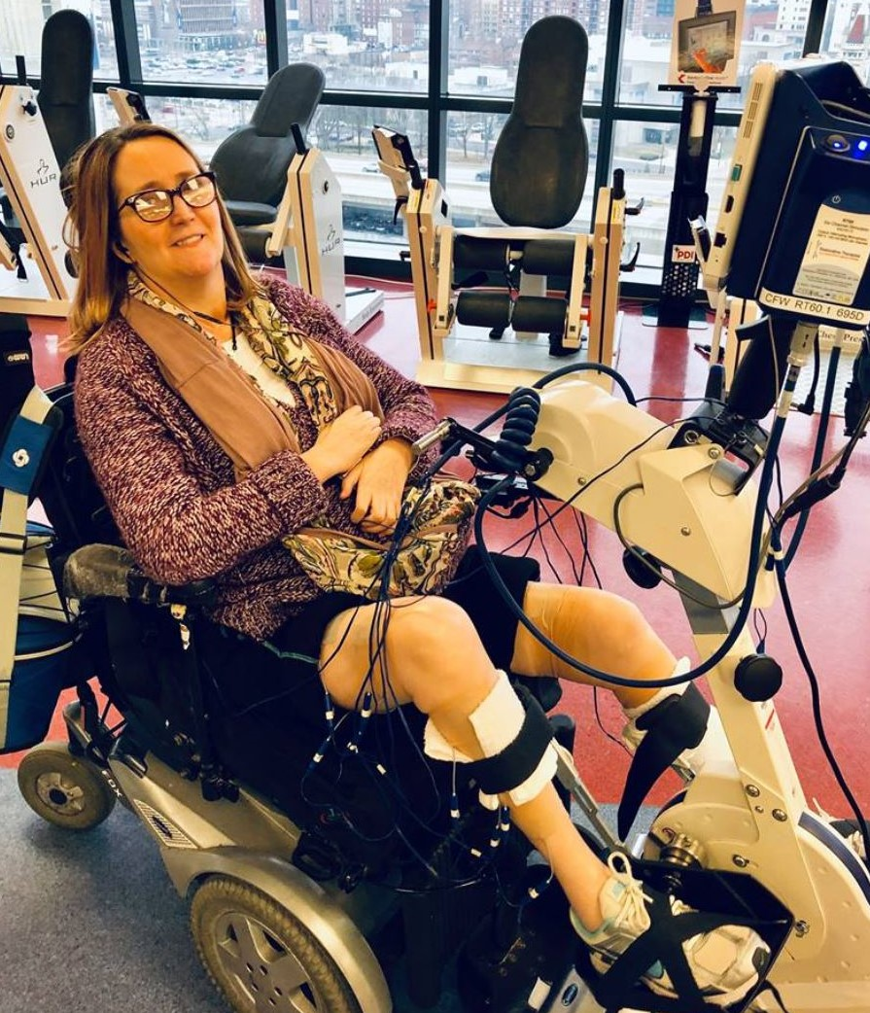
Gathering Strength Fund
The Gathering Strength Fund assists low-income people living with paralysis to participate in the therapeutic exercise opportunities at Frazier Rehab’s Community Fitness and Wellness (CFW) program in Louisville, which has been in operation for 10 years. The CFW is an innovative program that operates much like a fitness gym, but provides accessible exercise opportunities to people with disabling conditions, including a wide range of wheelchair-accessible cardiovascular and strength-training equipment, and innovative therapeutic techniques such as neuromuscular electrical stimulation (NMES), and a body-weight support system over a treadmill that facilitates weight-bearing and stepping therapy. This project provides financial assistance, on a sliding scale based on income, to help low-income people with paralysis afford the CFW fees.

Slide 9
Our Wellbeing -IDEAS xLab
The Our Wellbeing program builds on IDEAS xLab’s approach for leveraging community creativity and culture to transform lives. It focuses on co-creating arts-based experiences with individuals with paralysis and their support networks to measurably impact hope and wellbeing. By pairing participants with one or more artists with their lived experience, Our Wellbeing generates arts-based activities and learning opportunities for others to use in the future that are created using universal design.

Slide 10
HELP!
https://www.wellness4ky.org/wellnessedge/

Slide 11

Grant Writing Tips
Chithra Adams/Lindsey Mullis
wellnessedge@uky.edu

Slide 12
Proposal Criteria

Slide 13
1. Proposed activities must take place within a 12 month period, July 1, 2020-June 30, 2021.
Proposed activities must conclude by June 30, 2021.

Slide 14
2. Emphasis will be placed on education, training, providing service.
A grant application that proposes an archery camp for individuals with paralysis and their support networks will have more emphasis than a grant proposal on having an exposition fair on adaptive equipment.

Slide 15
Criteria
3. Emphasis will be placed on expansion of scope of current projects—A grant proposal that is going to recruit new team members to an existing archery camp will be scored higher than a grant proposal that is asking for funds to travel to an adaptive archery tournament.

Slide 16
4. Applicants must be Kentucky-based organizations.

Slide 17
5. Applicants must demonstrate an ability to provide structured or organized group activities which are intentionally designed to benefit individuals, groups or communities.

Slide 18

6. Preference will be given to applicants committed to providing inclusive activities (activities that are not aimed solely at people with disabilities).

Slide 19

7. Applicants should use person-first language when referring to people with disabilities.

Slide 20

8. Upon acceptance of the proposal, awardee agrees to work with Wellness Edge staff to enter into the University of Kentucky online subcontract system. Award payments will be made based upon completion of project milestones with final award payment made upon receipt of final report and final invoice. Final report and invoice must be received no later than June 25, 2021.

Slide 21
Milestones

Slide 22
Milestone Example

Slide 23
Requirements
Things to Consider

Slide 24
Things to Consider
Wellness Edge will not fund the following:
Organization overhead expenses
Medical services
Fundraising activities
New Construction (Ramps are exception )

Slide 25
Things to Consider
Data Reporting
  How many people are you serving?
    # people with paralysis
    # support networks
  How will get their feedback on the event/ camp/ service
  Who will administer a registration form?
  Who will administer the surveys?
  When to administer the surveys?

Slide 26
Things to Consider
Purchasing Equipment
Where will it be stored?
Will it be stored in a separate place during off season?
Who will be responsible for maintenance?
Do you have staff/contacts who can do repairs?

Slide 27
Outreach
Things to Consider
Inclusive, accessible materials
Administer in variety of ways
Reach out to other community partners who will help promote the project

Slide 28
Things to consider
Partnering
Who would you like to partner with in the future?
How can you involve them in the current project efforts (outreach, promotion, etc.)?
Letter of support of organizations with your proposal is critical

Slide 29
Things to Consider
Required Monthly Calls
30 minute calls
The structure of the calls
Financial updates
Activity updates
Numbers
Challenges
Opportunities

Slide 30
Things to Consider
Calendar of Events
Separate from grant timeline​
Keep Wellness Edge team aware of your activities​

Slide 31
Dates to Remember
3 April
Application goes live
22 May
Deadline for year two funding proposals
23–31 May
Review of proposals
1 June
Applicants notified
1 July 2019
Funding starts

